Slide 1
Client-Server Architecture
Working Process, Tiers, and Real-World Examples
-V Sivakumar Reddy

Slide 2
Introduction to Client-Server Architecture
Definition
Client-Server Architecture is a computing model where multiple clients interact with a centralized server that processes requests and provides services. It is widely used in web applications, cloud systems, and enterprise networks.
Importance
Efficient resource management through centralized control.
Multi-user accessibility for simultaneous interaction.
Security & reliability ensuring controlled access and secure transactions.

Slide 3
Working Process of Client-Server Architecture
Step-by-step process:
Client sends a request.
Server processes the request.
Response is sent back to the client.
Real-Time Example: When a user searches on Google, the browser (client) communicates with Google’s servers for data retrieval.

Slide 4
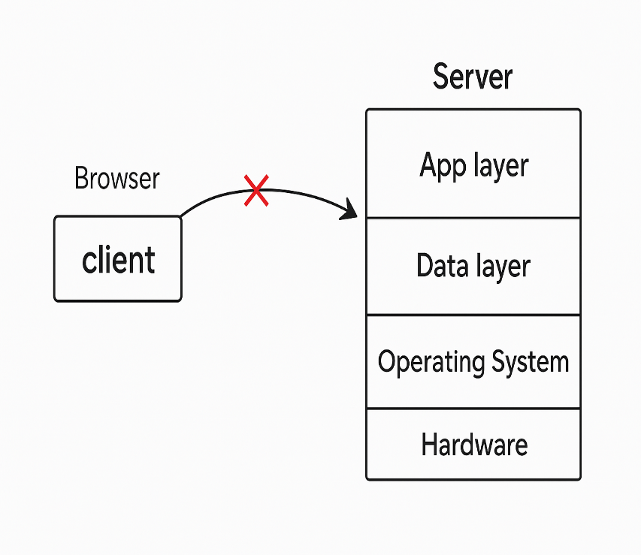
1-Tier Architecture (Standalone Applications)
Definition
1-Tier Architecture refers to a system where all components—user interface, business logic, and data storage—exist within a single application or machine. It does not require a separate server for processing or data management.
Example Scenario
Microsoft Word – Users can create and edit documents directly on their computer without needing an internet connection or an external server.
Advantages
Simple setup and easy to maintain.
No network dependency.
Disadvantages
Limited scalability and poor data sharing capability.
Not ideal for multi-user collaboration.

Slide 5
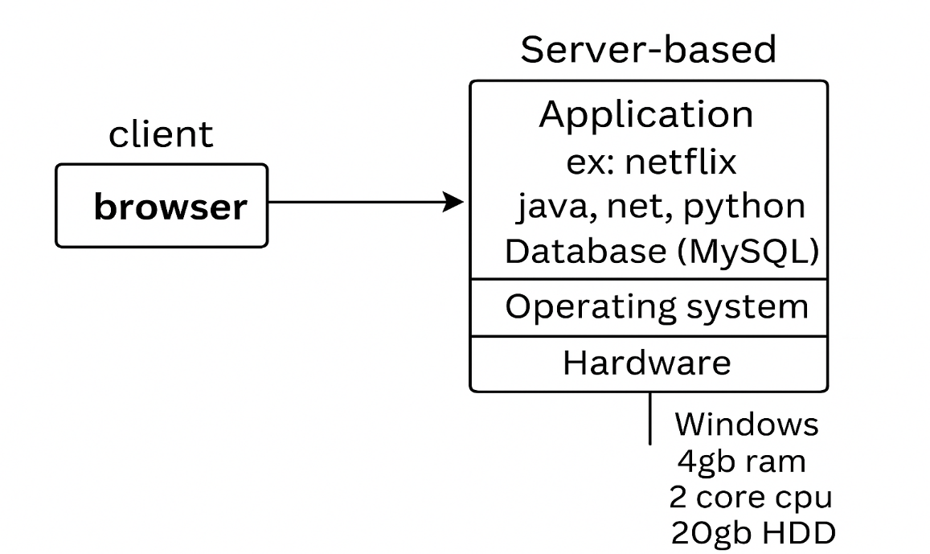
2-Tier Architecture (Client-Database Model)
Definition
2-Tier Architecture is a computing model where the client directly interacts with a database server to send requests and retrieve data. The processing happens either on the client side or the server side.
Example Scenario
Online Banking System – A customer enters their login details on the banking app (Client), which directly requests authentication and account data from the bank’s database (Server).
Advantages
Faster response times.
Secure and centralized data management.
Disadvantages
Heavy load on the database server.
Limited flexibility for large-scale applications.

Slide 6
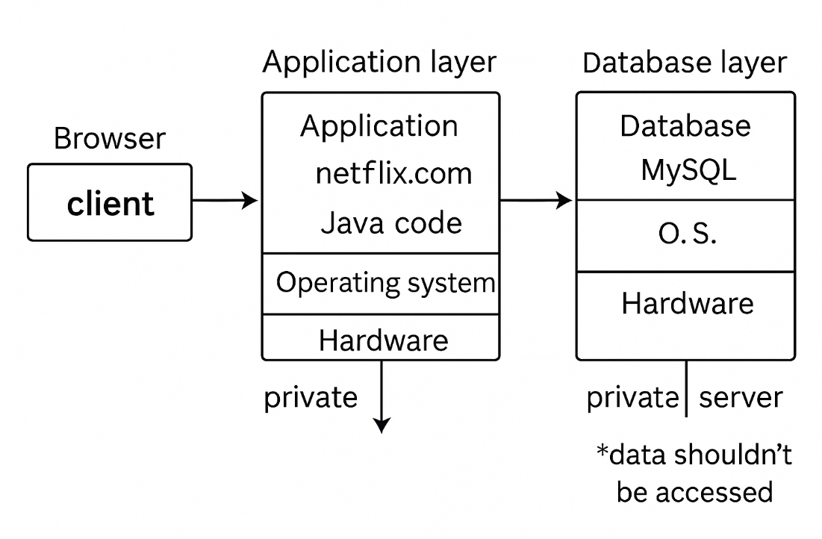
3-Tier Architecture (UI, Business Logic, Database)
Definition
3-Tier Architecture separates an application into three layers:
Presentation Layer (UI) – The user interface that interacts with the system.
Business Logic Layer – Processes requests and manages data flow.
Database Layer – Stores and retrieves data efficiently.
Example Scenario
E-commerce Website (Amazon, Flipkart)
Customer browses products (UI Layer).
System checks stock and applies discounts (Business Logic Layer).
Order details are stored and retrieved (Database Layer).
Advantages
Better scalability and security.
Easier updates and system management.
Disadvantages
More complex than 1-tier or 2-tier systems.
Requires additional infrastructure and maintenance.

Slide 7
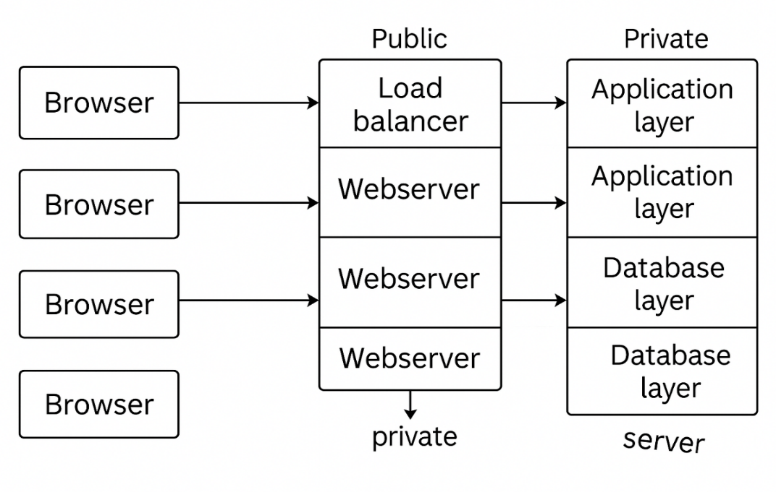
N-Tier Architecture (Cloud-based Distributed Systems)
Definition
N-Tier Architecture is a multi-layered computing model where different components—such as user interface, business logic, data storage, and cloud services—operate independently across multiple servers or locations. This setup enhances scalability, security, and efficiency for complex applications.
Example Scenario
Netflix Streaming Service
User requests a movie (Client Layer).
Application verifies subscription and recommends content (Business Logic Layer).
Streaming servers deliver video data efficiently (Media Layer).
Database stores user preferences and watch history (Data Layer).
Advantages
Highly scalable and flexible.
Supports distributed cloud services for global users.
Disadvantages
Requires high-speed internet.
Complex infrastructure and management.

Slide 8
Advantages of Client-Server Architecture
Centralized Management – Updates and security policies can be managed from a single server.
Scalability – Easily supports multiple clients without performance issues.
Improved Security – Controlled access and data encryption enhance protection.
Efficient Resource Usage – Servers handle processing, reducing load on client devices.
Data Integrity – Centralized storage ensures consistency and reduces duplication.

Slide 9
Disadvantages of Client-Server Architecture
Complexity – Requires structured setup and configuration.
Network Dependency – If the server goes down, clients cannot function properly.
High Initial Cost – Servers and maintenance require significant investment.
Scalability Challenges – As the number of clients increases, servers need upgrades.
Security Risks – If not properly managed, servers become targets for cyberattacks.
Latency Issues – Network delays can affect real-time responsiveness.
Single Point of Failure – If the central server fails, all connected clients are impacted

Slide 10
Conclusion:
Essential computing model enabling client-server interaction.
Supports various architectures (Standalone, Client-Database, Multi-tier).
Advantages include scalability, security, and centralized management.
Challenges involve network dependency, complexity, and cost.
Future trends: AI-driven automation, cloud computing, and edge computing.

Slide 11
THANK YOU

